Slide 1

Workshop: Introduction to SDTM Spencer Renyard

Slide 2
Purpose of CDISC Standards
Standardise data required for regulatory submission
Regulatory reviewers can use standard software to explore clinical trial data
Support plans to create a repository for all clinical trial data submitted to the FDA

Slide 3
Clinical Data Interchange Standards Consortium (CDISC)
“CDISC standards catalyze information flow through the entire pre-clinical and clinical research process, from study protocol and various sources of data collection to analysis and reporting through regulatory submission and electronic data archive.”
Which covers pretty much everything we do !

Slide 4
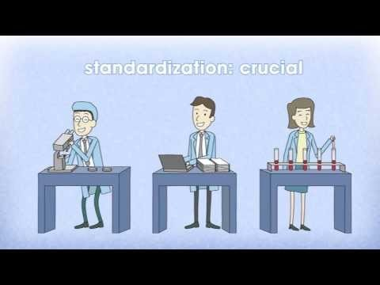
Purpose of CDISC Standards

Slide 5
Purpose of CDISC Standards
Standardise data required for regulatory submission
Regulatory reviewers can use standard software to explore clinical trial data
Support plans to create a repository for all clinical trial data submitted to the FDA

Slide 6
CDISC HISTORY
Late 1997 - Started as a Volunteer group
Late 1997 - Started as a Volunteer group
Summer 1998 - Invited to form DIA SIAC
1999 - SDS v1.0; ODM v0.8
2000 - SDS v1.1
Feb 2000 - formed an Independent, non-profit organization
Dec 2001 - Global participation
2001 - SDS v2.0; ODM v1.0
2002 - ODM v1.1; ADaM Models
2003 - LAB v1.0; SDTM v1/SDTM-IG v3.0;BRIDG Model Initiated; SEND 1.0
2004 - LAB v1.1; ODM v1.2; SDTM v3.1
2005 - Define.xml Implementation; Release (v1.0); SEND v.2; ODM v1.2.1; SDTM v1.1/SDTMIG v3.1.1; ODM mapped to HL7 RIM
2006 - BRIDG v1.0, v1.1; BRIDG posted as open source model
2007 - ODM v1.3; LAB & SDTM Aligned; BRIDG posted as open source model
2008 - BRIDG v2.0, v2.1, v2.2; CDASH v1.0; eSDI Document Published
2009 - SDTM v1.2/SDTMIG 3.1.2; ADam v2.1; Imaging CRFs; CDISC-IHE RFD and RPE
2010 - Protocol Representation Model;(PRM) v1.0; BRIDG v3.0; ODM v1.3.1; HHS-ONC/HITSP Interoperability Specification #158; CDISC-IHE RPE
2011 - CDASH v1.1; SEND v3.0; Study Design XML v1.0
2013 - SDTM v1.4/SDTMIG v3.2
2014 - SHARE R1
2016 – DatasetXML, Therapeutic Areas, CTR-XML
Feb 2000 - formed an Independent, non-profit organization
2003 - LAB v1.0; SDTM v1/SDTM-IG v3.0;BRIDG Model Initiated; SEND 1.0
2010 - Protocol Representation Model;(PRM) v1.0; BRIDG v3.0; ODM v1.3.1; HHS-ONC/HITSP Interoperability Specification #158; CDISC-IHE RPE
2014 - SHARE R1
2016 – DatasetXML, Therapeutic Areas
Notes:
https://en.wikipedia.org/wiki/Clinical_Data_Interchange_Standards_Consortium#History

Slide 7
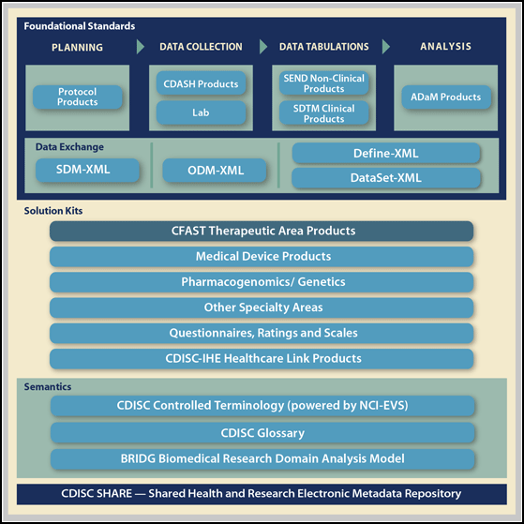
CDISC CONTENT
Notes:
https://www.cdisc.org/standards

Slide 8
SDTM

Slide 9
Notes
Latest available version is 3.2
Customer may still be using version 3.1.2 or 3.1.3
Customer may have own customisations
Location on PHASTAR server: PHASTAR Shared Folders\CDISC
CDISC website: www.cdisc.org/
SDTM standards: www.cdisc.org/standards/foundational/sdtm

Slide 10
Fundamentals of the SDTM

Slide 11
Observations and variables
Observation: a set of variables giving information about subjects who participated in a trial – one row in a dataset
Variable: one observation – one column in a dataset

Slide 12
Variable roles
Identifier: variables that identify a subject, study, domain or sequence number
Topic: variables which specify the focus of an observation (e.g. LBTEST)
Timing: variables which specify the timing of an observation
Qualifier: additional information that describe the results of the observation
Rule: expresses an algorithm or method in a trial design dataset

Slide 13
Qualifier variables
Grouping qualifier: used to group together observations (e.g. LBCAT)
Results qualifier: describes the collected results (e.g. LBORRES)
Synonym qualifier: specifies an alternative name for a particular variable (e.g. AEDECOD for AETERM)
Record qualifier: additional attributes of the observation record as a whole (e.g. LBREASND)
Variable qualifier: used to modify or describe a specific variable within an observation (e.g. LBORRESU)

Slide 14
Exercise: Variable roles
Looking at the lab page in the CRF, identify the role of each variable (write in pencil)

Slide 15
Domains and datasets
Observations are usually collected for all subjects
Domain: a set of related observations with a common topic
Each domain is represented by a single dataset
Domain have unique two-character codes that should be used consistently across a drug development project
SDTM includes the variable DOMAIN in all datasets
Datasets have rows representing observations and columns representing variables
Variable values are subject to controlled terminology – standardised formats

Slide 16
Special Purpose Datasets
There are three types of special purpose datasets that do not fall into the three general observation classes:
Domain Datasets: DM, CO, SE, SV – subject level data
Trial Design Model Datasets: TA, TE, TV, TI, TS – which represent information about the study design but do not contain subject data
Relationship Datasets: RELREC, SUPP

Slide 17
General Observation Classes
Most subject-level data can be categorised into three general observation classes:
Interventions: study treatments and procedures that are administered to the subject (e.g. CM, EX, SU)
Events: planned milestones (e.g. randomisation) and unplanned occurrences, conditions or incidents (e.g. AE, DS, MH, DV, CE)
Findings: observations resulting from evaluations, tests and questions listed on questionnaires (e.g. LB, EG, IE, PE, QS, SC, DA, VS, PC)

Slide 18
SDTM Standard Domain Models
Special-Purpose Domains
Comments (CO)
Demographics (DM)
Subject Elements (SE)
Subject Visits (SV)

Slide 19
SDTM Standard Domain Models
Interventions General Observation Class
Concomitant Medications (CM)
Exposure as Collected (EC)
Exposure (EX)
Substance Use (SU)
Procedures (PR)

Slide 20
SDTM Standard Domain Models
Events General Observation Class
Adverse Events (AE)
Clinical Events (CE)
Disposition (DS)
Protocol Deviations (DV)
Healthcare Encounters (HO)
Medical History (MH)

Slide 21
SDTM Standard Domain Models
Findings General Observation Class
Drug Accountability (DA)
Death Details (DD)
ECG Test Results (EG)
Inclusion/Exclusion Criterion Not Met (IE)
Immunogenicity Specimen Assessments (IS)
Laboratory Test Results (LB)
Microbiology Specimen (MB)
Microscopic Findings (MI)
Morphology (MO)
Microbiology Susceptibility Test (MS)
PK Concentrations (PC)
PK Parameters (PP)
Physical Examination (PE)
Questionnaires (QS)
Reproductive System Findings (RP)
Disease Response (RS)
Subject Characteristics (SC)
Subject Status (SS)
Tumor Identification (TU)
Tumor Results (TR)
Vital Signs (VS)

Slide 22
SDTM Standard Domain Models
Findings About
Findings About (FA)
Skin Response (SR)

Slide 23
SDTM Standard Domain Models
Trial Design Domains
Trial Arms (TA)
Trial Disease Assessment (TD)
Trial Elements (TE)
Trial Visits (TV)
Trial Inclusion/Exclusion Criteria (TI)
Trial Summary (TS)

Slide 24
SDTM Standard Domain Models
Relationship Datasets
Supplemental Qualifiers (SUPP-- datasets)
Related Records (RELREC)

Slide 25
Exercise: Domain Classes
For each page of the CRF, identify whether the page is collecting data that is a finding, intervention, event or special class.

Slide 26
General Dataset Rules
All datasets (domains) based on the general observation classes include STUDYID, USUBJID, DOMAIN and –SEQ
Timing and Qualifier variables are generally permissible
Any additional Qualifier variables from the same general observation class may be added to a domain model, except where restricted by specific domain assumptions.
Other variables may NOT be added – these variables are added to SUPP datasets
Standard variables MUST not be renamed or modified
“Permissible” variables that had no data collected may be dropped

Slide 27
Core Variables
There are three types of “core” variables:
Required: variable is basic to the identification of the observation – must be included and cannot be null for any record
Expected: variable necessary to make an observation useful – may contain some null values in exceptional cases.
Permissible: variable should be included where the data are available. If all values for this variable are null, the column can be dropped. If there are any data available, the column must be included.

Slide 28
ORIGIN variable
ORIGIN is included in metadata for all datasets. The value can be:
CRF: data were collected directly on the CRF
eDT: data were transferred electronically to the sponsor
Derived: calculated by an algorithm by the sponsor
Assigned: determined by individual judgement rather than collected in CRF or derived (e.g. adjudication results)
Protocol: part of the trial design preparation

Slide 29
Variable naming conventions
Variables ending in CD are a short form of another variable
--TESTCD must be no longer than 8 chars, cannot start with a number, and only contain characters, numbers and underscore
--TEST should be no more than 40 characters
Variable labels up to 40 characters should be provided
Standard datasets should use standard labels
Two character domain prefix is used in most variables, except:
STUDYID, DOMAIN, USUBJID
Common keys (VISIT, VISITDY, VISITNUM) and trial design variables
DM variables

Slide 30
SUBJID & USUBJID
Use “subject” and not “patient”
USUBJID should be unique across all studies
USUBJID is a required variable in all subject-level datasets
Notes:
“Subject” should be used where applicable to generically refer to both “patients” and “healthy volunteers” in order to be consistent with the recommendation in FDA guidance. The term “Subject” should be used consistently in all labels and Define-XML comments.
To identify a subject uniquely across all studies for all applications or submissions involving the product, a unique identifier (USUBJID) should be assigned and included in all datasets.
The unique subject identifier (USUBJID) is required in all datasets containing subject-level data. USUBJID values must be unique for each trial participant (subject) across all trials in the submission. This means that no two (or more) subjects, across all trials in the submission, may have the same USUBJID. Additionally, the same person who participates in multiple clinical trials (when this is known) must be assigned the same USUBJID value in all trials.

Slide 31
Variable rules
Recommended to use UPPER CASE for text
Exceptions can include:
Test names where the value will be presented as a label where title case would be preferable
Test names where the case of the text pertains to special meaning, such as PK parameter tests
Certain controlled terminology
External reference is not in upper case (e.g. MedDRA, LOINC)
Test units which are considered symbols rather than abbreviated text, e.g. “ng/mL”
Deviations to this rule should be described in the define.xml
Missing data should be represented by NULL values
“Specify” variables should be in SUPP datasets

Slide 32
Controlled terminology
Source: www.cancer.gov/research/resources/terminology/cdisc
Recommended to submit control terms in upper case
Deviations to this rule
If the external reference for the controlled terminology is not in upper case then the data should conform to the case prescribed in the external reference (e.g., MedDRA and LOINC).
Units, which are considered symbols rather than abbreviated text (e.g., mg/dL).
Numeric codes should be decoded
If a controlled terminology list is extensible additional terms can be added
AEs should have AEDECOD and AEBODSYS populated

Slide 33
Controlled terminology
Controlled terminology (CT) is now represented one of four ways:
A single asterisk when there is no specific CT available at the current time, but the SDS Team expects that sponsors may have their own CT and/or the CDISC Controlled Terminology Team may be developing CT.
A list of controlled terms for the variable when values are not yet maintained externally
The name of an external codelist whose values can be found via the hyperlinks in either the domain or by accessing the CDISC Controlled Terminology
A common format such as ISO 8601

Slide 34
Timing variables
All domains based on general observations classes should have at least one timing variable.
Dates and times are stored using ISO 8601 format – text based sortable date formats - (http://www.iso.org)
Variables holding date-times have names *DTC

Slide 35
Timing variables
Date-times are represented by YYYY-MM-DDThh:mm:ss
Where:
[YYYY] = four-digit year
[MM] = two-digit representation of the month (01-12, 01=January, etc.)
[DD] = two-digit day of the month (01 through 31)
[T] = (time designator) indicates time information follows
[hh] = two digits of hour (00 through 23) (am/pm is NOT allowed)
[mm] = two digits of minute (00 through 59)
[ss] = two digits of second (00 through 59)

Slide 36
Timing variables
Other characters defined for use within the ISO 8601 standard are:
[-] (hyphen): to separate the time Elements "year" from "month" and "month" from "day" and to represent missing date components.
[:] (colon): to separate the time Elements "hour" from "minute" and "minute" from "second“
[/] (solidus): to separate components in the representation of date/time intervals
[P] (duration designator): precedes the components that represent the duration
NOTE: Spaces are not allowed in any ISO 8601 representations

Slide 37
Timing variables – Dates
Dates are represented by YYYY-MM-DD
Hyphen delimiters are required
Partial dates can be stored e.g. “2012”, “2011-12”

Slide 38
Timing variables - Times
T is required only if a time is available
Colon delimiters are required
Partial times can be stored e.g. “13”, “13:14”

Slide 39
Timing variables – Intervals and Durations
Can represent an interval in multiple ways.
Could use two dates in the format: YYYY-MM-DDThh:mm:ss/YYYY-MM-DDThh:mm:ss
Both duration and duration units can be provided in the single --DUR variable
Format: PnYnMnDTnHnMnS or PnW where:
[P] (duration designator): precedes the alphanumeric text string that represents the duration
[n] represents a positive number or zero
[W] is used as week designator, preceding a data Element that represents the number of calendar weeks within the calendar year (e.g., P6W represents 6 weeks of calendar time)
Notes:
[P] (duration designator): precedes the alphanumeric text string that represents the duration. NOTE: The use of the character P is based on the historical use of the term "period" for duration.
The letter "P" must precede other values in the ISO 8601 representation of duration. The “n” preceding each letter represents the number of Years, Months, Days, Hours, Minutes, Seconds, or the number of Weeks. As with the date/time format, “T” is used to separate the date components from time components.
Note that weeks cannot be mixed with any other date/time components such as days or months in duration expressions.
ISO 8601 also allows that the "lowest-order components" of duration being represented may be represented in decimal format. This may be useful if data are collected in formats such as "one and one-half years", "two and one-half weeks", "one-half a week" or "one quarter of an hour" and the sponsor wishes to represent this "precision" (or
lack of precision) in ISO 8601 representation. Remember that this is ONLY allowed in the lowest-order (right-most) component in any duration representation.

Slide 40
Study day
Variables --DY, --STDY, --ENDY
Calculated from reference start date (DM.RFSTDTC)
Reference start date is study day 1
Day before reference start date is study day -1 (i.e. no zero)

Slide 41
Clinical encounters (visits)
There should be at least one timing variable
For planned visits, VISIT, VISITNUM and VISITDY should match TV
VISITNUM is used for sorting and should be chronological
One to one relationship between VISIT and VISITNUM
VISITNUM should be populated for all visits
VISIT may be left null or “UNSCHEDULED” for unplanned visits
VISITDY should only be populated for planned visits – it is the planned study day of the visit

Slide 42
Relative Timing
--STRF, --ENRF represent the timing of an observation relative to a sponsor defined reference period e.g. “BEFORE”, “AFTER”, “ONGOING”. The reference time period is defined by RFSTDTC and RFENDTC.
Allowable values : BEFORE, DURING, DURING/AFTER, AFTER, COINCIDENT, ONGOING, and U (for unknown)
Should only reflect raw data, and not be derived
If relative timing does not refer to reference time period, use
--STRTPT, --STTPT, --ENRTPT, --ENTPT.
--STRTPT and--ENRTPT contain values similar to --STRF and--ENRF
Anchor reference time interval referenced in --STTPT and --ENTPT

Slide 43
Relative Timing
Example: Adverse Events
CRF contains "Start Date", "Stop Date", and "Outcome" with check boxes including "Continuing" and "Unknown"
Example when "Unknown" is checked: AESTDTC = start date, e.g., “2015-09-01" AEENDTC = [null] AEENRTPT = "U" AEENTPT = final subject contact date, e.g., "2015-10-01"
Notes:
(Continuing and Unknown are asked at the end of the subject's study participation)
No assessment date or visit information is collected

Slide 44
Original and Standardised Results
--ORRES contains the original stated result
--ORRES is an expected variable so should always be non-missing
except when –STAT=“NOT DONE”
should generally not be populated for derived records
--STRESC should always be populated when --ORRES is populated, either by converting to standard units, or assigning a standardised value.
When --STRESC contains numeric results, these should be written to --STRESN. --STRESN should be left NULL for non-numeric results.
For numeric values with character operands e.g. “>10”, --STRESC should be populated and --STRESN left NULL (any imputation would happen at ADaM level)

Slide 45
Tests Not Done
When an entire exam is not done and this information is collected in the CRF, it should be present in the SDTM dataset
If the fact the data was not collected is not captured on the CRF, a record should not be created in SDTM
--TESTCD should be –ALL e.g. LBALL
--TEST should indicate the group of data missing (e.g. “Lab data”)
--CAT should indicate the category of missing data (e.g. “Chemistry”)
--ORRES should be NULL
--STAT should be “NOT DONE”
--REASND should state the reason the data were missing

Slide 46
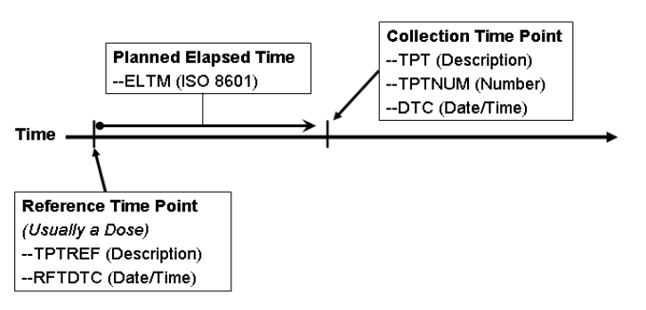
Time points
Represented using--TPT, --TPTNUM, --ELTM
Anchored by --TPTREF and –RFTDTC
Usually has an associated –DTC
--TPTNUM is expected when time points are used

Slide 47
Special Purpose Domains

Slide 48
DM: Demographics
The Demographics domain includes a set of essential standard variables that describe each subject in a clinical study. It is the parent domain for all other observations for human clinical subjects.
One record per subject
Demographics: Age, sex, race, ethnicity
Treatment information – planned and actual treatment arm
Country, site and investigator details

Slide 49
DM: Demographics
The Demographics domain includes a set of essential standard variables that describe each subject in a clinical study. It is the parent domain for all other observations for human clinical subjects.
Holds reference start and stop timing information
the start and stop of treatment
the start and stop of exposure to any protocol-specified treatment or therapy
date of consent
date when subject ended participation or follow-up in a trial, as defined in the protocol, i.e. date of last contact
date of death

Slide 50
Exercise: Map the demography CRF
By writing on the dummy study CRF, map each of the variables to SDTM
Do not map any variables that you do not think can be mapped to standard variables in the SDTM.DM domain

Slide 51
CO: Comments
The Comments dataset accommodates two sources of comments:
those collected alongside other data on topical case report form (CRF) pages such as Adverse Events
those collected on a separate page specifically dedicated to comments
One record per comment per subject
The Comments special-purpose domain provides a solution for submitting free-text comments related to data in one or more SDTM domains
Comments are generally not responses to specific questions; instead, comments usually consist of voluntary, free-text or unsolicited observations

Slide 52
CO: Comments
The Comments dataset accommodates two sources of comments:
those collected alongside other data on topical case report form (CRF) pages such as Adverse Events
those collected on a separate page specifically dedicated to comments
Three sources:
Comments unrelated to a domain
Comments related to a domain
Comments related to a group of records or a specific record
RDOMAIN links back to the domain being commented upon
IDVAR and IDVARVAL to link back to an observations domain
E.g. IDVAR = AESEQ
IDVAR/IDVARVAL is set to null if there is a COMMENTS page on CRF

Slide 53
CO: Comments
The Comments dataset accommodates two sources of comments:
those collected alongside other data on topical case report form (CRF) pages such as Adverse Events
those collected on a separate page specifically dedicated to comments
COREF – company defined reference for comments e.g. CRF page
COVAL is used to store the comment text
If more than 200 characters are required, use additional variables COVAL1, COVAL2, etc.

Slide 54
Elements & Epochs
An Element is a basic building block in the trial design. It involves administering a planned intervention, which may be treatment or no treatment. If a treatment is given, the element should specify the given treatment e.g. “Screen”, “Placebo”, “10 mg”, “Follow-up”
An Epoch is a period of time with a specific purpose in the trial. Epoch should be the same across all treatments in a study. e.g. “Screen Epoch”, “First Treatment Epoch”, “Follow-up Epoch”, “Double Blind”, “Open Label”

Slide 55
SE: Subject Elements
The Subject Elements dataset consolidates information about the timing of each subject’s progress through the Epochs and Elements of the trial.
Particularly useful for studies with multiple treatment periods, such as crossover studies
Trial design datasets describe the planned design of the study (e.g. TE, TA, TV)
Actual data also needs to be recorded:
Arm is recorded in DM.ARM
Actual elements are recorded in SE (subject elements)
Actual visits are recorded in SV (subject visits)

Slide 56
SE: Subject Elements
SE dataset contains timing of subjects’ elements and epochs as they progress through a trial.
Element data (that involve treatment) are likely to come from exposure information
Comparison of a --DTC variable to the ELEMENT transition dates SESTDTC and SEENDTC tell which ELEMENT the subject was in at the time of a finding.
SE can contain unplanned elements
Important Note: the FDA has requested EPOCH be added to most SDTM datasets (see CDER Common Data Standards Issues Document (Version 1.1/December 2011), page 4)
Notes:
http://www.fda.gov/downloads/Drugs/DevelopmentApprovalProcess/FormsSubmissionRequirements/ElectronicSubmissions/UCM254113.pdf

Slide 57
SE: Subject Elements
TAETORD should represent the planned order of elements
SDTM IG states that the value of SEENDTC should be the same as SESTDTC for the next element – this causes lots of practical problems in deciding which events on the transition dates fall into which element. A conservative approach is usually needed (i.e. assume safety events occur on-treatment)

Slide 58
SV: Subject Visits
The Subject Visits domain consolidates information about the timing of subject visits that is otherwise spread over domains that include the visit variables (VISITNUM and possibly VISIT and/or VISITDY).
Used to consolidate information on actual subject visits that would otherwise be spread across all other domains
Planned visits are stored in SDTM.TV
Visits may reflect data that are collected over a number of days (e.g. tumour scans)
May involve derivations (unless beginning and end of each visit is explicitly collected)

Slide 59
SV: Subject Visits
The Subject Visits domain consolidates information about the timing of subject visits that is otherwise spread over domains that include the visit variables (VISITNUM and possibly VISIT and/or VISITDY).
Simple case is that there is one unique date for each subject visit
Unplanned visits should be included in SDTM.SV
VISITDY is the planned day of the visit. Null for unplanned visits.

Slide 60
Domains based on General Classes: Interventions

Slide 61
CM: Concomitant Medications
Case report form (CRF) data that captures the concomitant and prior medications/therapies used by the subject. Examples are the concomitant medications/therapies given on an as needed basis and the usual background medications/therapies given for a condition.
One record per recorded intervention occurrence or constant-dosing interval per subject
Prior and ongoing information that is recorded in the data should be mapped to CMSTRF and CMENRF
For outputs, we usually need to identify meds that start before treatment, and those that start on-treatment – a study decision should be made on how to do this early in the programming/specs stages – it is probably better to derive variables at ADaM stage

Slide 62
CM: Concomitant Medications
Case report form (CRF) data that captures the concomitant and prior medications/therapies used by the subject. Examples are the concomitant medications/therapies given on an as needed basis and the usual background medications/therapies given for a condition.
I.G. states that CMSTRF and CMENRF should not be derived at SDTM level (should only reflect the raw data collected)

Slide 63
EX: Exposure
The Exposure domain model records the details of a subject's exposure to protocol-specified study treatment. Study treatment may be any intervention that is prospectively defined as a test material within a study, and is typically but not always supplied to the subject.
One record per protocol-specified study treatment, constant-dosing interval, per subject
EXTRT captures the name of the protocol-specified study treatment and is the topic variable. It is a Required variable and must have a value
EXCAT and EXSCAT may be used when appropriate to categorize treatments into categories and subcategories

Slide 64
EC: Exposure as Collected
The Exposure as Collected domain model reflects protocol-specified study treatment administrations, as collected.
One record per protocol-specified study treatment, collected-dosing interval, per subject, per mood
EC should be used in all cases where collected exposure information cannot or should not be directly represented in EX, e.g. administrations collected in tablets but protocol-specified unit is mg.
Collected exposure data are in most cases represented in a combination of one or more of EC, DA, or FA domains. If the entire EC dataset is an exact duplicate of the entire EX dataset, then EC is optional and at the sponsor’s discretion.
Details in the IG, including examples for EX and EC
Notes:
Mood:
Mode or condition of the record specifying whether the intervention (activity) is intended to happen or has happened. Values align with BRIDG pillars (e.g., scheduled context, performed context) and HL7 activity moods (e.g., intent, event). Examples: SCHEDULED, PERFORMED. CDISC Controlled Terminology request for MOOD codelist with values of SCHEDULED and PERFORMED has been submitted.

Slide 65
EC: Exposure as Collected
Danuta reviewed paper at PhUSE EU Connect 2018
P:\PHASTAR Shared Folders\Programming Forum\16 Jan 2019 - PhUSE 2018 Recap
Practical benefits of EC: building a comprehensive exposure story
https://www.lexjansen.com/phuse/2018/ds/DS02.pdf
https://www.lexjansen.com/phuse/2018/ds/DS02_ppt.pdf

Slide 66
Practical benefits of EC
How can we document the exposure?
EC (Exposure as collected)
EC (Exposure as collected)
Factual recording
Flexibility in actual dose recording
Accurate
Traceable
Clearly structured
EX (Exposure)
Actual exposure
Easily analysable
Derived from EC using the data in EC, protocol data, unblinding data, medication logs,...
Notes:
The Exposure domain model (EX) records the details of a subject's exposure to protocol-specified study treatment. As EX is ultimately used for the statistical analysis, it should be concise and easily analysable. However, if EX is the only exposure capturing domain, it can become too cluttered or miss essential information.
To facilitate the accurate capturing of the exposure data, the EC Domain was introduced. Since the inclusion of EC in SDTM IG 3.2, exposure data can be collected as it is present in the esource or the eCRF. The EX dataset is derived afterwards from the EC and other relevant data sources (like for example from the randomization data, medication logs ...).

Slide 67
Summary of EC
Unblinding in an orderly fashion
Capturing relevant exposure information
Factual data entry
Per dose traceability
Multiple dose medications
Complex dosing schemes
EC (Exposure as collected)

Slide 68
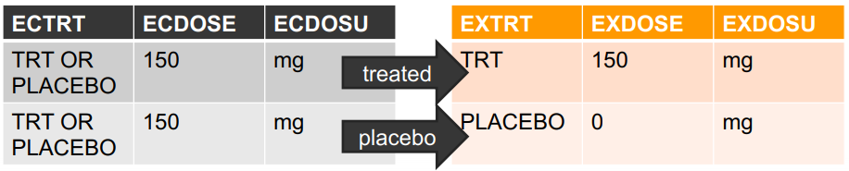
Unblinding in an orderly fashion
ECTRT | is a general placeholder term and EC contains the exposure data as it is captured
EXTRT | describes the actual medication and EX contains the exposure data for analysis
Notes:
Once the data is unblinded, we can derive EX, based on the EC dataset and the information in the randomization log. EC remains untouched at the time of unblinding.
We can see an example with a Placebo-controlled trial. ECTRT is a general term. ECDOSE contains the theoretical dose. After unblinding, EXTRT is specified correctly and EXDOSE is recalculated.

Slide 69
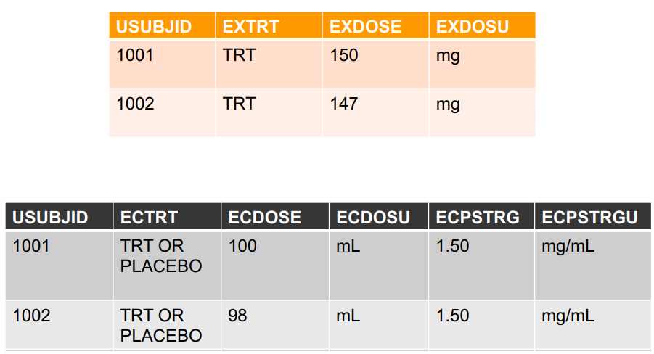
Capturing relevant exposure information
Notes:
EC can also be used to capture relevant exposure information without cluttering up EX and SUPPEX. The information captured in EC can document why the concentration in EX is not as expected, or it can document errors in exposure which might not be visible in EX.
Here’s an example with a dosing inconsistency for an intravenous exposure. We can see the origin of the calculated EXDOSE discrepancy for subject 1002 can be traced back to an incorrect volume administered, rather than an incorrect solution concentration.

Slide 70
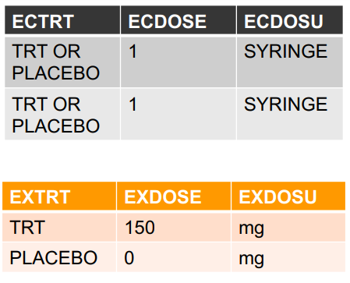
Factual data entry
Notes:
EC is entered factually correct without making unknown assumptions. EX is then derived based on additional information. In this case the randomization list and the apothecary medication log.

Slide 71
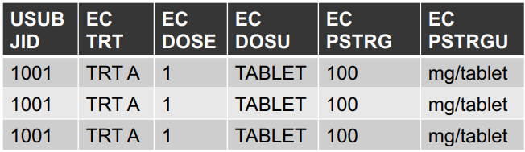

Per dose traceability
Notes:
For some trials, the individual tables or capsules are coded and this information should remain present in the database. However, this information is often not important for the actual analysis. For example here the subject was given 3 coded tablets at a single visit.

Slide 72
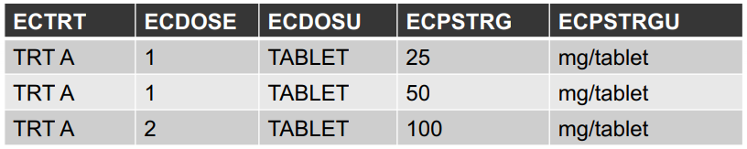
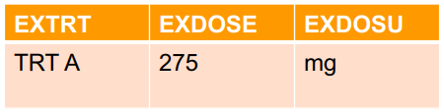
Multiple dose medications
Notes:
To simplify the manufacturing process, the doses can be prepared by combining tablets with different concentrations. Exposures with different dosages can be entered in EC as separate entries and combined in EX as a single entry, to facilitate the analysis.

Slide 73
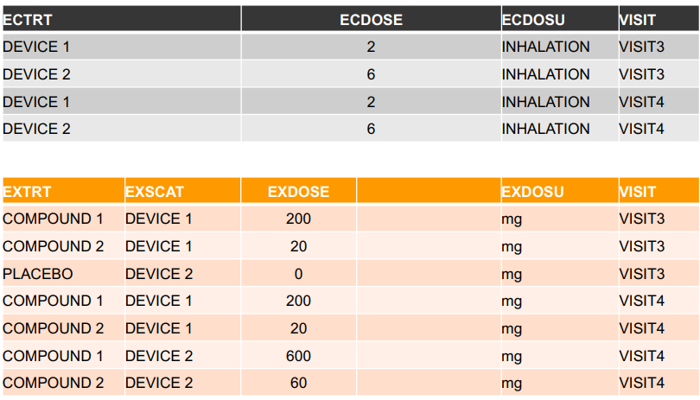
Complex dosing schemes
Notes:
Using EC facilitates that by enhancing the traceability between the recorded dosing in EC and the derived value in EX. For example, in trials where a combination of multiple active and placebo exposures are performed within the same exposure time point, we can establish an easily traceable link between the performed exposure, the randomization data and the derived data.

Slide 74
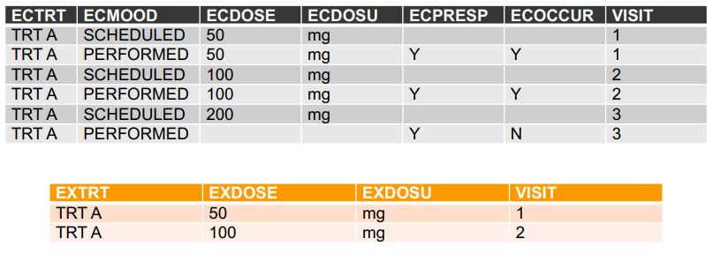
Scheduled or performed exposures
Notes:
Finally this slide is to mention also some other relevant variables in EC. ECMOOD can be used to document both the scheduled and the performed exposures in EC. When deriving EX, only the performed records for which the occurrence is marked as Yes in EC will create a record in EX.
So here we can see here 6 records in EC summarized in 2 records in EX.
The ECMOOD parameter contains the mode or condition of the record specifying whether the intervention is intended to happen or has happened. ECPRESP defines whether an exposure is prespecified in the (e)CRF; and the ECOCCUR records whether or not a prespecified records occurred.

Slide 75
PR: Procedures
The Procedures domain model reflects collected details describing a subject’s therapeutic and diagnostic procedures.
One record per recorded procedure per occurrence per subject
Examples of therapeutic and diagnostic procedures:
disease screening
endoscopic examinations
diagnostic tests
therapeutic procedures
surgical procedures
Notes:
Therapeutic and diagnostic procedures. Some example procedures by type include the following:
a. disease screening (e.g., mammogram, pap smear)
b. endoscopic examinations (e.g., arthroscopy, diagnostic colonoscopy, therapeutic colonoscopy, diagnostic laparoscopy, therapeutic laparoscopy)
c. diagnostic tests (e.g., amniocentesis, biopsy, catheterization, cutaneous oximetry, finger stick, fluorophotometry, imaging techniques (e.g., DXA scan, CT scan, MRI), phlebotomy, pulmonary function test, skin test, stress test, tympanometry)
d. therapeutic procedures (e.g., ablation therapy, catheterization, cryotherapy, mechanical ventilation, phototherapy, radiation therapy/radiotherapy, thermotherapy)
e. surgical procedures (e.g., curative surgery, diagnostic surgery, palliative surgery, therapeutic surgery, prophylactic surgery, resection, stenting, hysterectomy, tubal ligation, implantation)

Slide 76
SU: Substance Use
The intent of the domain is to capture substance use information that may be used to assess the efficacy and/or safety of therapies that look to mitigate the effects of chronic substance use.
One record per substance type per reported occurrence per subject
Substance use information frequently collected includes:
Alcohol
Smoking
Drugs
Caffeine

Slide 77
Domains based on General Classes: Events

Slide 78
AE: Adverse Events
Adverse events may be captured either as free text or a pre-specified list of terms.
One record per adverse event per subject
For outputs, we usually need to identify AEs that start before treatment, and those that start on-treatment – a study decision should be made on how to do this early in the programming/specs stages – it is probably better to derive variables at ADaM stage
AETRTEM – is this derived in SDTM?
The FDA in the Study Data Technical Conformance Guide (March 2017) highlights that there is no variable
Historically, requested that variable be added to SDTM even though derived
Notes:
https://www.fda.gov/downloads/ForIndustry/DataStandards/StudyDataStandards/UCM384744.pdf
AE Domain (Adverse Events (AE))
Currently, there is no variable in the AE domain that indicates if an AE was “treatment emergent.” The AE domain should include all adverse events that were recorded in the subjects’ case report forms, regardless of whether the sponsor determined that particular events were or were not treatment-emergent.

Slide 79
Exercise: Map the Adverse Events Page
By writing on the dummy study CRF, map the variables on the adverse event page to SDTM
Do not map any variables that you do not think can be mapped to standard variables in the SDTM.AE domain
Do not include the section “Changes in CTCAE grade…” at this time

Slide 80
CE: Clinical Events
Captures clinical events that would not be classified as AEs (e.g. signs and symptoms of the disease under study)
One record per event per subject

Slide 81
DS: Disposition
DS - A subject domain utilized for the submission of information encompassing and representing data, vocabulary or records related to disposition. (NCI)
One record per disposition status or protocol milestone per subject
May include protocol milestones (e.g. randomisation), as well as completion status
DSTERM should be the reported term
DSDECOD should be a standardised term (subject to controlled terminology)
DSDTC: date and time of collection
DSSTDTC: start date and time of disposition event

Slide 82
Exercise: Map the Disposition Data
By writing on the dummy study CRF, any variables in the whole CRF to SDTM.DS as you see appropriate
Do not map any variables that you do not think can be mapped to standard variables in the SDTM.DS domain

Slide 83
MH: Medical History
The medical history dataset includes the subject's prior history at the start of the trial. Examples of subject medical history information could include general medical history, gynaecological history, and primary diagnosis
Includes past and current medical conditions
Past vs current may be indicated by MHENRTPT (“Ongoing” or “Before”)

Slide 84
Exercise: Map the Medical History Page
By writing on the dummy study CRF, map the variables on the medical history page to SDTM
Do not map any variables that you do not think can be mapped to standard variables in the SDTM.MH domain

Slide 85
DV: Protocol Deviations
The intent of the domain is to capture protocol violations and deviations during the course of the study and will store only those criteria violation by or deviated from by the subject and not a response to each violation or deviation.
IMPORTANT: SDTM.DV is only for deviations that are explicitly collected in the CRF. Derived protocol deviations should not be introduced at SDTM level.
This domain should not be used to collect entry criteria information. Violated inclusion/exclusion criteria are stored in IE
If there are no CRF collected protocol deviations, then this dataset is not included. In this case, an ADaM dataset can still be produced containing derived deviations.

Slide 86
DV: Protocol Deviations
The intent of the domain is to capture protocol violations and deviations during the course of the study and will store only those criteria violation by or deviated from by the subject and not a response to each violation or deviation.
Where a study team has a separate record of deviations (e.g. a spreadsheet), this may be considered raw data and mapped to SDTM. The approach in this case will need to be defined on a study by study basis.

Slide 87
HO: Healthcare Encounters
The Healthcare Encounters dataset includes inpatient and outpatient healthcare events (e.g., hospitalizations, nursing home stay, rehabilitation facility stays, ambulatory surgery)
Values of HOTERM typically describe the location or place of the healthcare encounter (e.g., HOSPITAL instead of HOSPITALIZATION)
HOSTDTC should represent the start or admission date and HOENDTC the end or discharge date
The supplemental qualifier, QNAM = ‘HOINDC’, should represent the indication or reason for the encounter.

Slide 88
Domains based on General Classes: Findings

Slide 89
EG, LB, PE, VS, SC, DA
Usually straightforward to map
--STRESC should contain a value if --ORRES contains a value
--STRESN should only contain numeric results (not coded character results)
--BLFL is one example of a derived variable that is required in SDTM
SC is for subject level data not mapped to other domains – it is an extension of the DM data. SC data would not normally change during the trial.
Notes:
BLFL – Basline flag
ORRES – Original Results
SC – Subject Characteristics

Slide 90
Exercise: Map the Lab Data
By writing on the dummy study CRF, map the variables on the lab data page to SDTM

Slide 91
IE: Inclusion/Exclusion Criteria
Only includes records where entry criteria are not met
This domain should not be used to collect protocol deviations/violations incurred during the course of the study
If the entry criterion is more than 200 characters, summarise it and add the full text to the study metadata in define.xml
Notes:
The IE (and CO, already covered) domain handles long text strings differently to the standard SDTM approach.
Some sponsors may collect data values longer than 200 characters for some variables. Because of the current requirement for Version 5 SAS transport file format, it will not be possible to store those long text strings using only one variable. Therefore, the SDTMIG has defined a convention for storing a long text string by using a combination of the standard domain dataset and the Supplemental Qualifiers (SUPP--) datasets, which applies to all domains based on a general observation class. Note that the Comments domain is not based on a general observation class
and has different rules. See Section 5 - CO Domain for information on handling comment text more than 200 characters long.
The first 200 characters of text should be stored in the standard domain variable and each additional 200 characters of text should be stored as a record in the SUPP-- dataset [see Section 8: 8.4, Relating Non-Standard Variables Values to a Parent Domain]. In this dataset, the value for QNAM should contain a sequential variable name, which is formed by appending a one-digit integer, beginning with 1, to the original standard domain variable name.

Slide 92
QS: Questionnaires
Questionnaires are named, stand-alone instruments designed to provide an assessment of a concept.
Questionnaires have a defined standard structure, format, and content; consist of conceptually related items that are typically scored; and have documented methods for administration and analysis.
Most often, questionnaires have as their primary purpose the generation of a quantitative statistic to assess a qualitative concept.

Slide 93
QS: Questionnaires
CDISC publishes standard Questionnaire Supplements to the SDTMIG along with controlled terminology
Captures patient reported outcomes (e.g. SF-36)
QSCAT: Questionnaire name
Value subject to controlled terminology
QSSCAT: Subscale name (if appropriate)
QSTESTCD: Short name for the value in QSTEST
QSTEST: Verbatim name of the question or group of questions used to obtain the measurement or finding
Notes:
If the verbatim question text is > 40 characters, put meaningful text in QSTEST and describe the full text in the study metadata. See Section 4: 4.1.5.3.1, Test Name (--TEST) Greater Than 40 Characters for further information.

Slide 94
QS: Questionnaires
QSORRES: Finding as originally received or collected (e.g. RARELY, SOMETIMES)
QCSTRESC: Contains the finding for all questions or sub-scores, copied or derived from QSORRES in a standard format or standard units
QCSTRESN: Used for continuous or numeric findings in standard format; copied in numeric format from QSSTRESC
Notes:
QSORRES: Finding as originally received or collected (e.g. RARELY, SOMETIMES). When sponsors apply codelist to indicate the code values are statistically meaningful standardized scores, which are defined by sponsors or by valid methodologies such as SF36 questionnaires, QSORRES will contain the decode format, and QSSTRESC and QSSTRESN may contain the standardized code values or scores.
QCSTRESC: Contains the finding for all questions or sub-scores, copied or derived from QSORRES in a standard format or standard units. QSSTRESC should store all findings in character format; if findings are numeric, they should also be stored in numeric format in QSSTRESN. If question scores are derived from the original finding, then the standard format is the score. Examples: 0, 1. When sponsors apply codelist to indicate the code values are statistically meaningful standardized scores, which are defined by sponsors or by valid methodologies such as SF36 questionnaires, QSORRES will contain the decode format, and QSSTRESC and QSSTRESN may contain the standardized code values or scores.

Slide 95
QS: Questionnaires
Derived total scores can be stored in SDTM.QS (although best to add these at ADaM level)
Consult the published Questionnaire Supplements for guidance on submitting derived information in SDTM
Derived records that are submitted in the QS domain should be flagged by QSDRVFL and identified with appropriate category/subcategory names (QSSCAT), item names (QSTEST), and results (QSSTRESC, QSSTRESN)

Slide 96
FA: Findings About
Specialisation of general findings class
Holds findings about interventions or events
FAOBJ variable relates the finding to an intervention or event
Can be used to store how severity changes over time with adverse events

Slide 97
FA: Findings About
Variable unique to Findings About
--OBJ: in conjunction with FATESTCD, it describes what the topic of the observation is
The value in FAOBJ should match the value in --TERM or --TRT, unless the parent domain is dictionary coded or subject to controlled terminology, in which case FAOBJ should then match the value in –DECOD
Lots of examples in the IG

Slide 98
Exercise: CTCAE grades
Map the section on the adverse event page titled “Changes in CTCAE grade…” to SDTM

Slide 99
SR: Skin Response
First implementation of the Findings About concept that is Findings About an Intervention and uses a different domain code instead of FA
The SR domain is a Findings About domain used to submit dermal responses to antigens. The method of assessment is typically a skin-prick test
Because a subject is typically exposed to many test materials at the same time, SROBJ is needed to represent the test material for each response record

Slide 100
Pharmacokinetic Domains: PC and PP
PC: Pharmacokinetics Concentrations
Concentrations of drugs/metabolites in fluids or tissues as a function of time.
PP: Pharmacokinetics Parameters
Pharmacokinetic parameters derived from pharmacokinetic concentration-time (PC) data.

Slide 101
PC: Pharmacokinetics Concentrations
Data collected about tissue (e.g., serum or plasma) concentrations of analytes (usually study drugs and/or their metabolites) as a function of time after dosing the study drug.
The structure is one record per concentration or sample characteristic per analyte.
In addition to one record for each concentration measurement, specimen properties (e.g., volume and pH) are handled via separate records in this dataset.
The following Qualifiers would not generally be used in PC: --BODSYS, --SEV.

Slide 102
PP: Pharmacokinetics Parameters
PP Definition: Data describing the parameters of the time-concentration curve for PC data
It is recognized that PP is a derived dataset, and may be produced from an analysis dataset that might have a different structure
The structure is one record per PK parameter per time-concentration profile per subject
Information pertaining to all parameters (e.g., number of exponents, model weighting) should be submitted in the SUPPPP dataset.
The following Qualifiers would not generally be used in PP: --BODSYS, --SEV.
Notes:
PP Definition: Data describing the parameters of the time-concentration curve for PC data (e.g., area under the curve all, maximum concentration, time of maximum observed concentration sampled during a dosing interval).

Slide 103
PC-PP – Relating PP Records to PC Records
It is a requirement that sponsors document the concentrations used to calculate each parameter. For many sponsors, this need is currently met via the analysis metadata. As a result of feedback received from many sponsors on the draft version of this document, sponsors may continue to document the concentrations used to calculate each parameter via the analysis datasets.

Slide 104
Oncology Domains: TU, TR and RS
Assessment of the change in tumour burden is an important feature of the clinical evaluation of cancer therapeutics
The tumor package consists of three SDTM domains based on the SDTM Findings Observation Class
The three domains are related but each has a distinct purpose

Slide 105
TU: Tumor Identification
The TU domain represents data that uniquely identifies tumors
The tumors are identified by an investigator and/or independent assessor and classified according to the disease assessment criteria
In RECIST terms this equates to the identification of Target, Non-Target or New tumors

Slide 106
TU: Tumor Identification
A record in the TU domain contains the following information:
a unique tumour ID value
anatomical location of the tumour
method used to identify the tumour
role of the individual identifying the tumour
timing information

Slide 107
TU: Tumor Identification
TRLNKID is used to relate an identification record in TU domain to assessment records in the TR domain
The TULNKID variable is used to provide a unique code for each identified tumour
The values of TULNKID are compound values that may carry the following information:
an indication of the role (or assessor) providing the data record when it is someone other than the principle investigator;
an indication of whether the data record is for a target or non-target tumour
a tracking identifier or number
an indication of whether the tumour has split or merged

Slide 108
TR: Tumor Results
The TR domain represents quantitative measurements and/or qualitative assessments of the tumours identified in the TU domain
These measurements are usually taken at baseline and then at each subsequent assessment to support response evaluations
Notes:
The TR domain represents quantitative measurements and/or qualitative assessments of the tumours i.e. malignant tumours and other sites of disease, e.g. lymph nodes) identified in the TU domain

Slide 109
TR: Tumor Results
A record in the TR domain contains the following information:
a unique tumour ID value
test and result
method used
role of the individual assessing the tumour
timing information
The TR domain does not include anatomical location information on each measurement record because this would be a duplication of information already represented in TU

Slide 110
TR: Tumor Results
TRLNKID is used to relate records in the TR domain to an identification record in TU domain
TRLNKGRP is used to relate records in the TR domain to a response assessment record in RS domain
TRTESTCD / TRTEST values for this domain are published as Controlled Terminology

Slide 111
RS: Disease Response
The RS domain represents the response evaluation(s) determined from the data in TR.
Data from other sources (in other SDTM domains) might also be used in an assessment of response.

Slide 112
RS: Disease Response
RSTESTCD / RSTEST values for this domain are published as Controlled Terminology
RSCAT is used to identify the criteria used in the assessment of response and a version number if appropriate

Slide 113
SUPP datasets
SDTM does not allow addition of new variables
Supplementary Qualifiers special purpose dataset model is used to capture non-standard variables
Individual SUPP-- for each domain (SDTMIG v3.1.1 introduced single SUPPQUAL dataset option, now depreciated)
SUPP-- has a set of keys: STUDYID, RDOMAIN, USUBJID
IDVAR and IDVARVAL are used to identify related record
QNAM, QLABEL, QVAL give details of name and value of non-standard variable
QORIG: Origin of data (e.g. CRF)
QEVAL: Evaluator of data (e.g. ADJUDICATION COMMITTEE)

Slide 114
When not to use SUPP--
Subject level data that should go in SC
Interpretations of findings that should be added as an additional test code e.g. EGTESTCD = “INTP”
Comments relating to records - should go in CO
Data not directly related to the parent domain

Slide 115
Exercise: SUPP-- variables
Identify all variables that do not fit into standard SDTM domains and should be mapped as supplementary qualifier variables.

Slide 116
Trial Design Datasets
A structured model for describing the design of clinical trials
The standard Trial Design Datasets will allow reviewers to:
clearly and quickly grasp the design of a clinical trial
compare the designs of different trials
search a data warehouse for clinical trials with certain features
compare planned and actual treatments and visits for subjects in a clinical trial
Useful definitions are given for EPOCH, ELEMENT, ARM, STUDY CELL etc. in section 7.1.2 in the SDTM IG

Slide 117
Trial Design Datasets
Current trial design includes modules for:
Trial Arms: describes the sequences of Elements in each Epoch for each Arm, and thus describes the complete sequence of Elements in each Arm.
Trial Elements: describes the Elements used in the trial.
Trial Visits: describes the planned schedule of Visits.
Trial Disease Assessment: provides information on the protocol-specified disease assessment schedule, and will be used for comparison with the actual occurrence of the efficacy assessments in order to determine whether there was good compliance with the schedule
Trial Inclusion/Exclusion: describes the inclusion/exclusion criteria used to screen subjects.
Trial Summary: lists key facts (parameters) about the trial that are likely to appear in a registry of clinical trials.

Slide 118
Trial Design Datasets
Future versions of the Trial Design Model are expected to include additional aspects of clinical trials
some of these additional aspects will be used in submissions, while others are needed for accurate representation of protocols for the planning stage, but will have limited effects on the SDTM.
The current Trial Design Model has limitations in representing protocols, which include the following:
plans for indefinite numbers of repeating Elements (e.g., indefinite numbers of chemotherapy cycles)
indefinite numbers of Visits (e.g., periodic follow-up Visits for survival)
indefinite numbers of Epochs
indefinite numbers of Arms

Slide 119
TA: Trial Arms
The trial arms table describes each planned arm in the trial. An arm is described as an ordered sequence of elements
ARM: Description of planned arm
TABRANCH: Condition that a subject has to meet to be included in this arm
TATRANS: If it is possible for a subject to transition to various elements (other than the next element in sequence) then the transition rule should be stated here
One record per planned element per arm
Lots of useful examples in SDTM IG

Slide 120
TE: Trial Elements
The Trial Elements (TE) dataset contains the definitions of the elements that appear in the Trial Arms (TA) dataset
ELEMENT: Description of the Element
TESTRL: Rule for start of Element
TEENRL: Rule for end of Element
There are no gaps between Elements; the instant one Element ends, the next Element begins. A subject spends no time “between” Elements

Slide 121
TV: Trial Visits
The Trial Visits (TV) dataset describes the planned Visits in a trial. Visits are defined as "clinical encounters" and are described using the timing variables VISIT, VISITNUM, and VISITDY.
Protocols define Visits in order to describe assessments and procedures that are to be performed at the Visits.
Describes the planned visits in the trial
One record per visit per arm
VISIT: Planned visit name
VISITDY: Planned visit day
TVSTRL: Visit start rule
TVENRL: Visit end rule

Slide 122
TD: Trial Disease Assessments
The TD domain provides information on the protocol-specified disease assessment schedule, and will be used for comparison with the actual occurrence of the efficacy assessments in order to determine whether there was good compliance with the schedule.
TDANCVAR: identifies the variable in ADSL that holds the “anchor” date. By default, the anchor variable for the first pattern is ANCH1DT
TDSTOFF: A fixed offset from the date provided by the variable referenced in TDANCVAR
This domain should not be created when the disease assessment schedule may vary for individual subjects, for example when completion of the first phase of a study is event driven
Notes:
TDANCVAR: identifies the variable in ADSL that holds the “anchor” date. By default, the anchor variable for the first pattern is ANCH1DT. An anchor date must be provided for each pattern of assessments and each anchor variable must exist in ADSL. TDANCVAR is therefore a Required variable. Anchor date variable names should adhere to ADaM variable naming conventions (e.g. ANCH1DT, ANCH2DT, etc). One anchor date may be used to anchor more than one pattern of disease assessments. When that is the case, the appropriate offset for the start of a subsequent pattern, represented as an ISO 8601 duration value, should be provided in the TDSTOFF variable
The TDSTOFF variable is used in conjunction with the anchor date value (from the anchor date variable identified in TDANCVAR). If the pattern of disease assessments does not start exactly on a date collected on the CRF, this variable will represent the offset between the anchor date value and the start date of the pattern of disease assessments. This may be a positive or negative interval value represent in an ISO 8601 format.

Slide 123
TI: Trial Inclusion/Exclusion
The Trial Inclusion Exclusion (TI) dataset is not subject oriented. It contains all the inclusion and exclusion criteria for the trial, and thus provides information that may not be present in the subject-level data on inclusion and exclusion criteria
One record per inclusion / exclusion criteria
TIRL: computer-executable form of criteria
IETEST contains the text of the inclusion/exclusion criterion. However, since entry criteria are rules, the variable TIRL has been included in anticipation of the development of computer executable rules
If criteria are amended during trial, TIVERS is used to indicate version
Notes:
If a criterion text is <200 characters, it goes in IETEST; if the text is >200 characters, put meaningful text in IETEST and describe the full text in the study metadata. See Section 4: 4.1.5.3.1, Test Name (--TEST) Greater Than 40 Characters for further information.

Slide 124
TS: Trial Summary
The Trial Summary (TS) dataset allows the sponsor to submit a summary of the trial in a structured format
One record per parameter description
The intent of this dataset is to provide a summary of trial information. This is not subject-level data.
TSPARM, TSPARMCD: Trial summary parameter (e.g. AGEMIN, AGEMAX, INDIC, etc.)
Subject to Controlled Terminology
TSVAL: Parameter value
There is a list of trial summary parameters in appendix C1 of SDTM IG v3.2

Slide 125
Exercise: Create TS and TE
For the example study provided, create in EXCEL a version of TS that describes as many of the trial design parameters as you can.
For the example study provided, create in EXCEL a version of TE that describes the elements in the study as fully as you can.

Slide 126
Not covered
Creating new domains – section 2.6
Microbiology domains – section 6.3
Some of the new domains – HE, DD, IS, MI, MO, RP, SS, SR
Describing relationships amongst data – section 8
Anything relating to define.xml

